Slide 1
If I were President Simulation
Background and National Interests

Slide 2
Simulation Timeline
Background and National Security Interests
  National Interests
  President Elected & Roles Selected
Simulation
Setting the Stage – 10 minutes
Policy Group Meeting – 20 minutes
Executive Meeting – 20 minutes
Oval Office Meeting – 10 minutes
Press Conference – 10 minutes
Debrief – 10 minutes

Slide 3
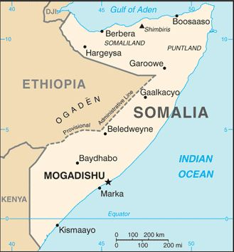
What are the key elements of the scenario?

Slide 4
National Interests
The national interest of a country is the set of objectives that seek to improve the well-being of the nation.
Promotion of Values
Favorable World Order
Economic Prosperity
Stability
What does the US have at stake?
What does Somalia stand to gain or loose?

Slide 5
Tools of National Power
Nations use various types of power to achieve their national interest.
  D - Diplomatic Power - tends to be politically neutral and includes actions of diplomacy, agreements, coalitions, humanitarian assistance and technological assistance.
  I - Informational Power - is political in nature and includes making threats and distributing propaganda in order to gain support and appreciation for a nation’s foreign policy.
  M - Military Power - utilizes a nation’s military resources through actions such as moving ships toward a troubled region, establishing bases abroad, military aid, threats, war and peacekeeping.
  E - Economic Power - employs the strength of nation’s economy by manipulating trade, sanctions, economic aid and embargoes to achieve a nation’s interest

Slide 6
Simulation Roles
Intelligence and Security Group
• Chair of the Joint Chiefs of Staff
• Secretary of Defense
• Director of the Federal Bureau of Investigation
• Commander of the U.S. Africa Command
(AFRICOM)
Trade and Humanitarian Group
• Administrator of the U.S. Agency for International
Development
• Secretary of the Treasury
• U.S. Trade Representative
• Under Secretary for Democracy and Global Affairs
• Liaison of the Secretary-General of the International Maritime Organization
Legislative Group
• Chair of the House Committee of Foreign
Affairs
• Chair of the Senate Armed Services Committee
• Speaker of the House of Representatives
• Senate Majority Leader
President
White House Group
• Vice President of the United States
• National Security Advisor
• White House Chief of Staff
• Assistant to the President for Domestic Policy
Press Secretary
• Press Secretary
• Assistant to the President for Foreign Policy
Diplomacy Group
• Secretary of State
• U.S. Ambassador to the U.N.
• U.S. Counselor for Somali Affairs
• Asst. Secretary for the Bureau of Near-Eastern Affairs
• Chair of the Board of the U.S. Institute of Peace

Slide 7
Policy Making
During the If I Were President simulation you will be taking on the role of one of the officials needed to help the President make their decision over the crisis in Somalia, your role card will give you the information you need to help make your policy decisions.
For the simulation prepare 2-3 role specific policy options and read pages 4-17.

