Slide 1
Chase the race 2016 Lesson plan: Picking POTUS

Slide 2
What iS Democracy? Who are the Demos?

Slide 3
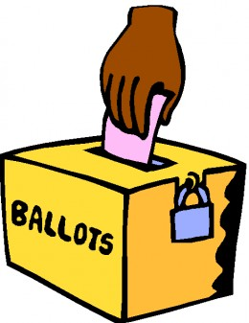
Democracy
A system of government in which power is vested in the people, who rule either directly or through freely elected representatives
According to dictionary.com

Slide 4
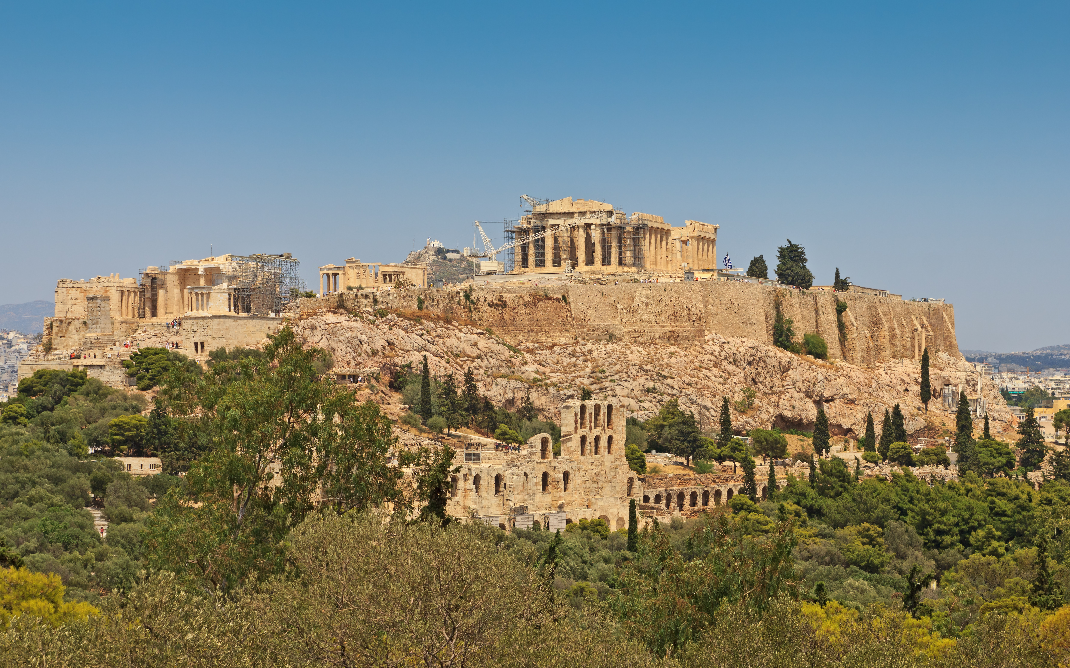
DEMOS
Definition: The common people; the people; the masses
The term originated in ancient Greece
According to dictionary.com

Slide 5
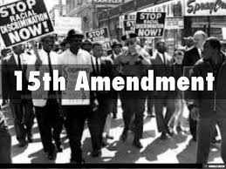
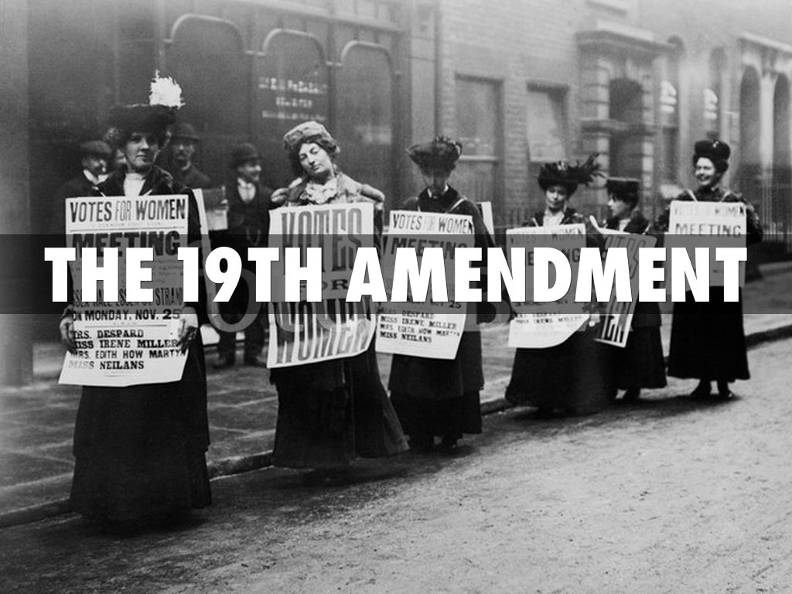
Who makes up the American Demos today?
Through time the American demos has changed:
1787 – Voting eligibility was left to the states and in most states only white men, 21+ who owned property could vote
1870 – 15th Amendment: Prohibits citizens from being denied based on race, color or servitude, which grants African American men the right to vote
1920 – 19th Amendment: Prohibits citizens from being denied based on their sex, which grants women the right to vote
1924 – Federal Indian Citizenship Act: Grants Native Americans citizenship and thus the right to vote
1971 – 26th Amendment: Establishes 18 as the legal voting age for all citizens

Slide 6
How do we Select the American President?

Slide 7
The U.S. Election System Explained
Video from The Telegraph explaining the elections process

Slide 8
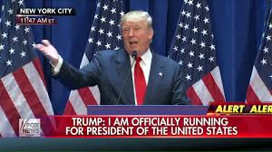
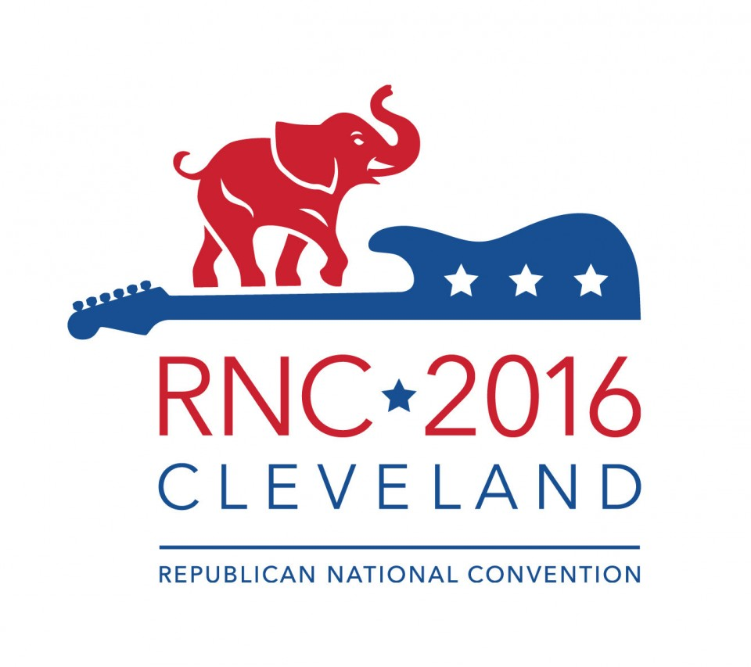
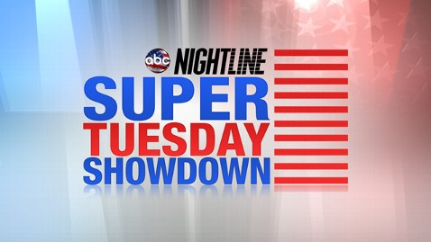
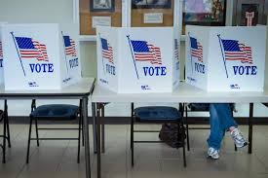
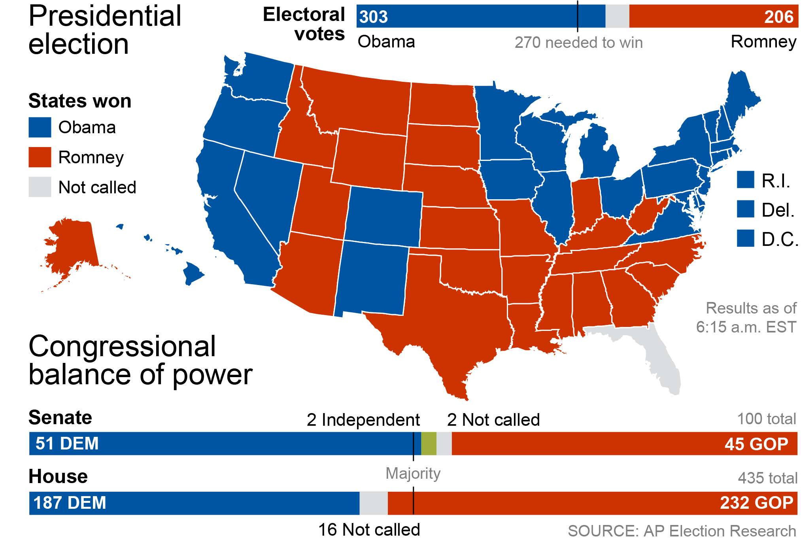
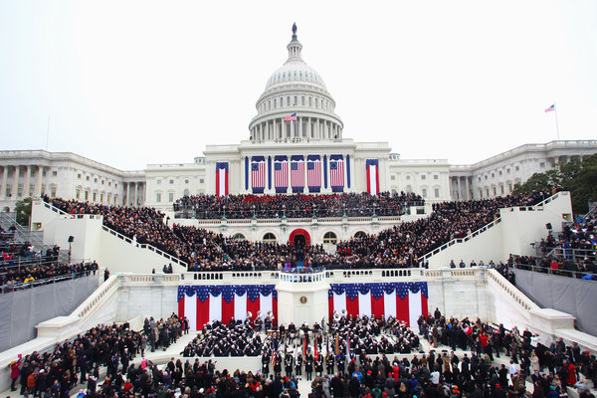
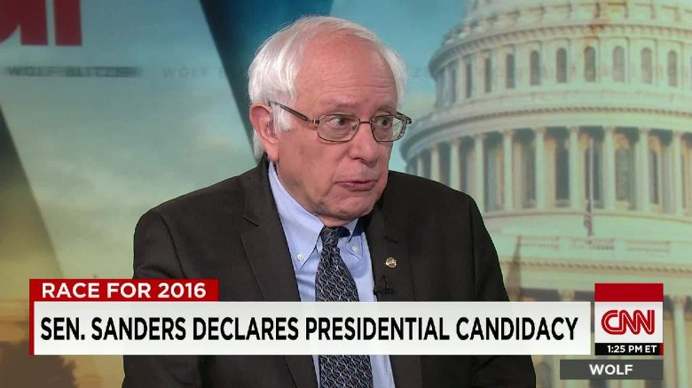
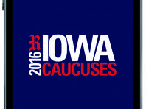
The road to the White House
Declare Candidacy
Primary Elections or Caucuses
Nomination at Party National Conventions
Election Day
Electoral College
Inauguration

Slide 9
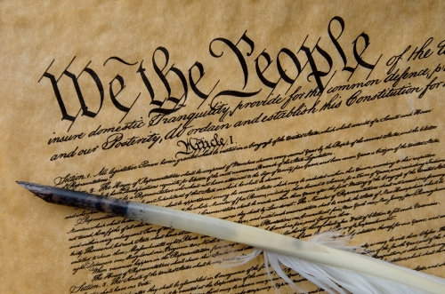
Declaring Candidacy
Eligibility
Article II, Section 1, Clause 5 in the Constitution establishes requirements for President
Natural born citizen
At least 35 years old
Resident of the U.S. for at least 14 years
File paperwork with FEC (Federal Election Commission). Must file paperwork when $5,000 in donations is received or expenses worth $5,000.
Hold Press Conference

Slide 10
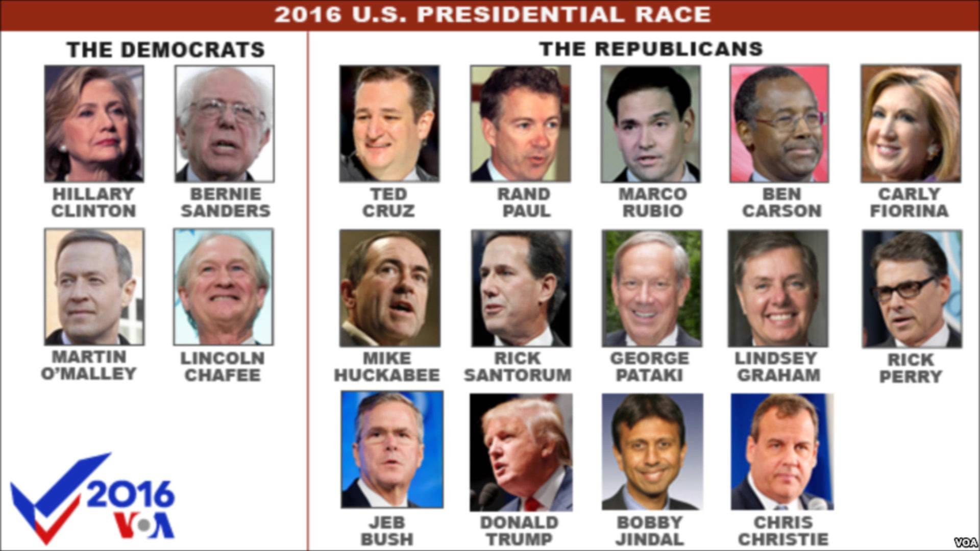
From Declaring to the Primaries
Candidates need to gain support
Fundraise
Campaign
Primary Debates
11 Republican & 8 Democratic debates for 2016 election

Slide 11
Primary or Caucus
Is this democracy?
Open vs Closed Primaries
Open – voters are not required to declare party affiliation
Closed – only voters registered for the party may vote
Primaries or caucuses occur from February to June 2016
Each state’s Republican & Democrat parties set procedures for the primary or caucus
Primary Election – voters vote for their choice of Republican or Democrat candidate
Most states hold a primary election
Caucus – meeting in which supporters decide on their choice of candidate
The following states hold caucuses vs. primaries: Iowa, Nevada, Minnesota, Colorado, Nebraska, Kansas, Maine, Alaska, Hawaii, Wyoming, Utah

Slide 12
National Conventions
Is this democracy?
Super Delegates
Republicans – approx.103 of 2472 delegates
Democrats – approx. 712 of 4763 delegates
Republicans and Democrats hold a convention in the summer to officially nominate their candidate for President
Delegates vote for their candidate
Delegates are chosen at the state level from primaries or caucus results, to vote for a specific candidate. Also known as pledged delegates.
Super Delegates are prominent members of their party and can vote for their choice. Also known as unpledged delegates.
Usually by the Conventions there is a clear nominee and other candidates have dropped out

Slide 13
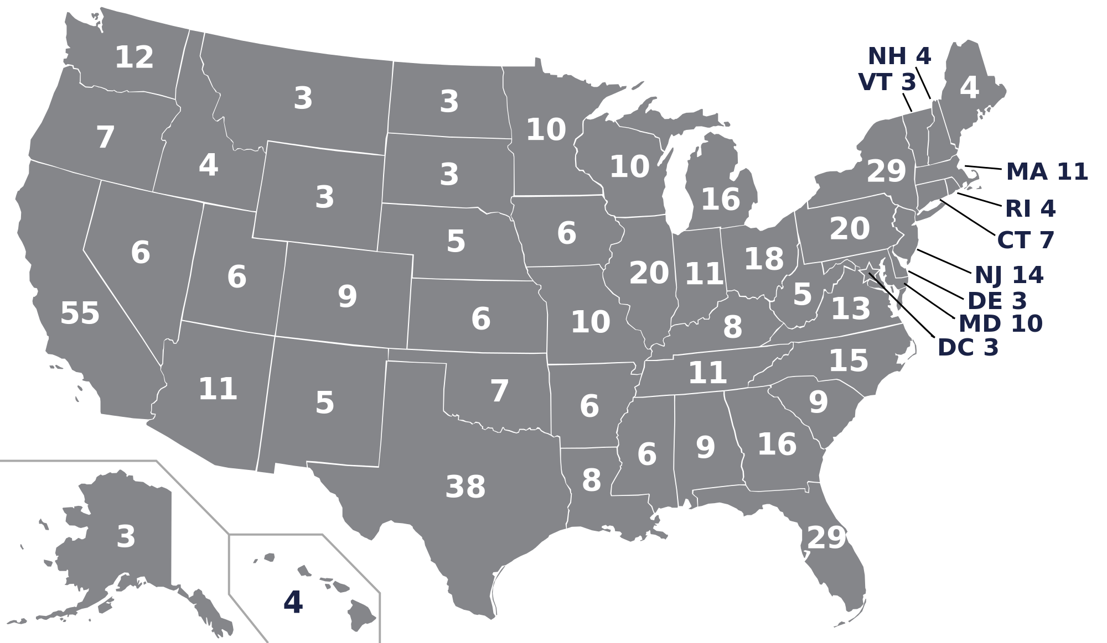
Election Day
November 8, 2016
Voters go to the polls and vote for their choice for President
Often called the popular vote
President isn’t decided by the popular vote, but instead the Electoral College

Slide 14
Electoral College
Is this democracy?
Popular vote winter takes all electoral votes in a state
On election day, voters cast their vote for President in the popular vote
Electoral votes are determined by the popular vote and then it is winner-take-all by state, except in Maine & Nebraska
The number of electors per state is equal to the number of seats that state holds in Congress
2 Senators + x Representatives
Washington D.C. has 3 electoral votes – as established by the 23rd Amendment in 1961
CA-55, TX-38, NY-29, FL-29, IL-20, PA-20
AK, DE,MT,ND,SD,VT & WY each have 3
270 of the 538 electoral votes required to become President
Electors meet and cast their votes on December 19, 2016
Congress counts and certifies electoral votes in January

Slide 15
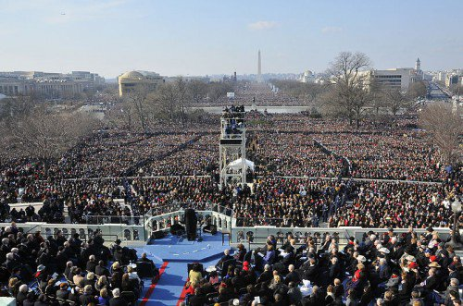
Inauguration
January 20, 2017 the President is sworn into office

Slide 16
Is the American presidential selection PROCESS democratic?

